Slide 1
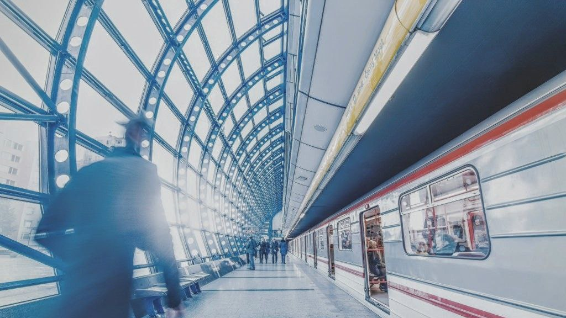
Railway Tracking & Arrival Time Prediction
Graduation Project

Slide 2




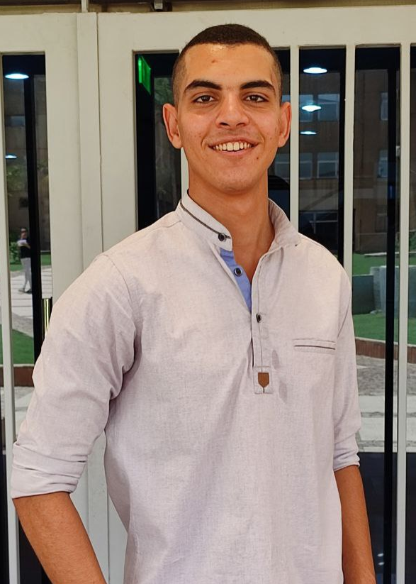
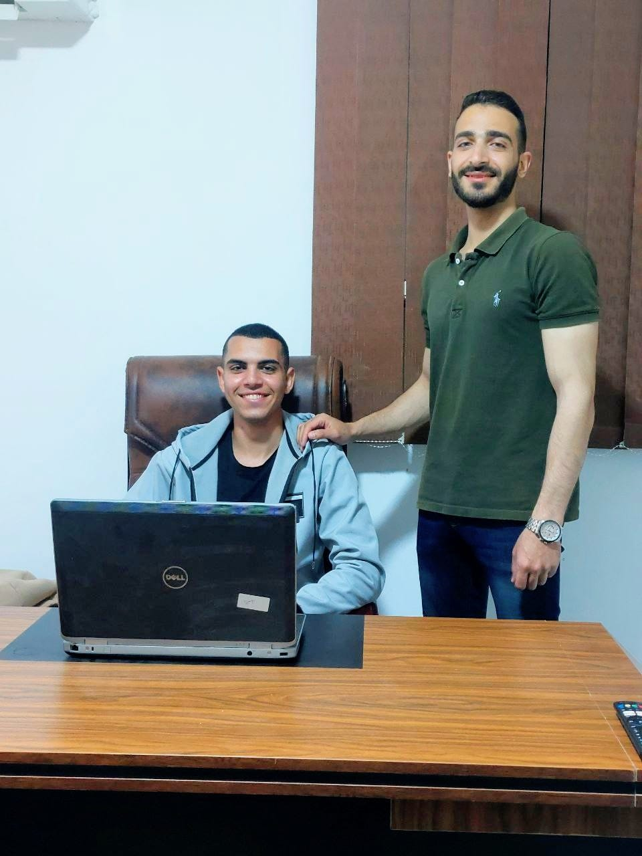

Supervised by : Dr. Wael Mohamed
Our Team
Front End
Abdelrahman Ashraf
Aya Abdallah
Donia Ahmed
Backend
Mostafa Abdelbaky
Omar Ahmed
Shahenda Hemdan

Slide 3
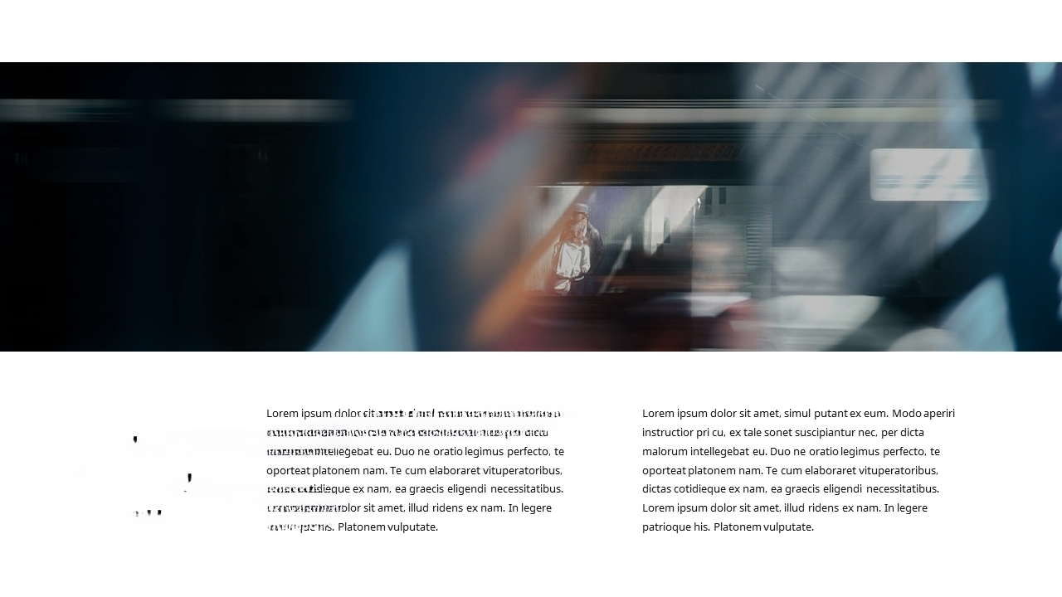



Introduction
The challenges that train passengers face is the delay of trains and the uncertainty of their arrival times at stations.
These issues can cause considerable inconvenience and frustration for commuters.
Train delays can be caused by a variety of factors such as technical issues, weather conditions, maintenance work.

Slide 4
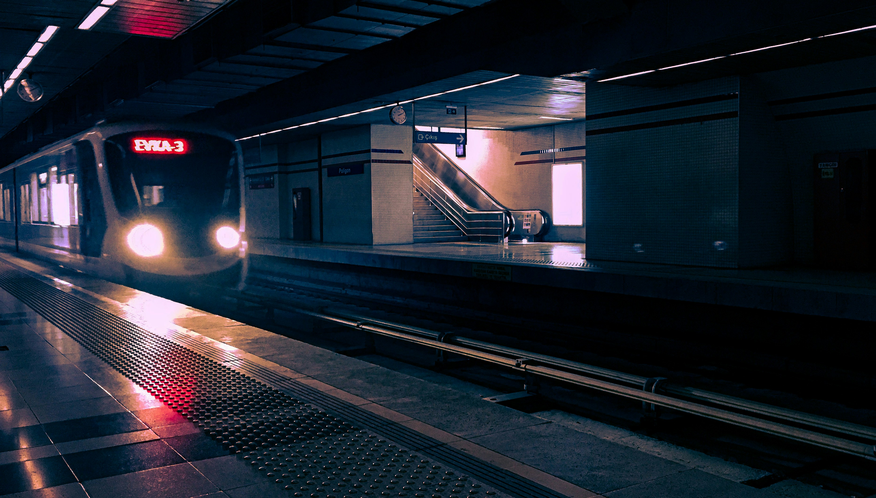
The main idea of this project is to develop a comprehensive system that leverages advanced technologies to track trains in real-time and accurately predict their arrival times at various stations. This system aims to address the common challenges faced by passengers, such as unpredictable delays and the lack of reliable information about train schedules.
Project Main Idea

Slide 5
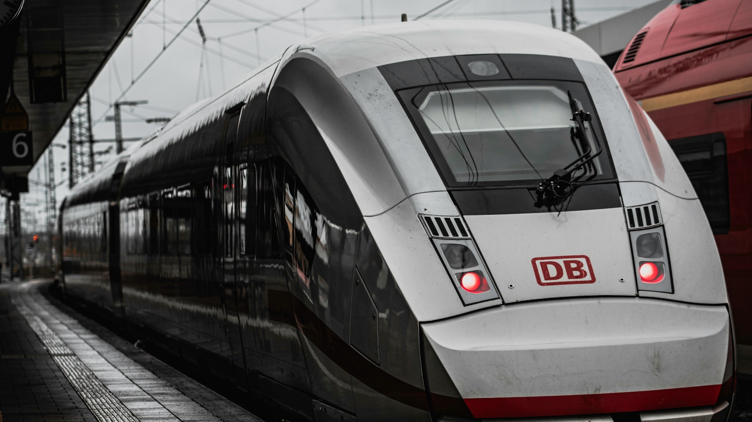
How it works ?
(1)
(2)
(3)
(4)
(5)
Data Collection:
Sensors : Gather data on train speed, track conditions, and locations.
Apache Kafka : Stream sensor data to Kafka for
real-time processing.
Data Processing:
Apache Spark : Read and process data from Kafka in real-time
Data Storage:
Database : Store processed data in a database ( MYSQL ).
Real-Time Dashboard:
Server-Sent Events (SSE) : Push real-time updates to the dashboard.
Machine Learning Predictions:
Delay Prediction : Use machine learning models to predict train delays based on collected data.

Slide 6
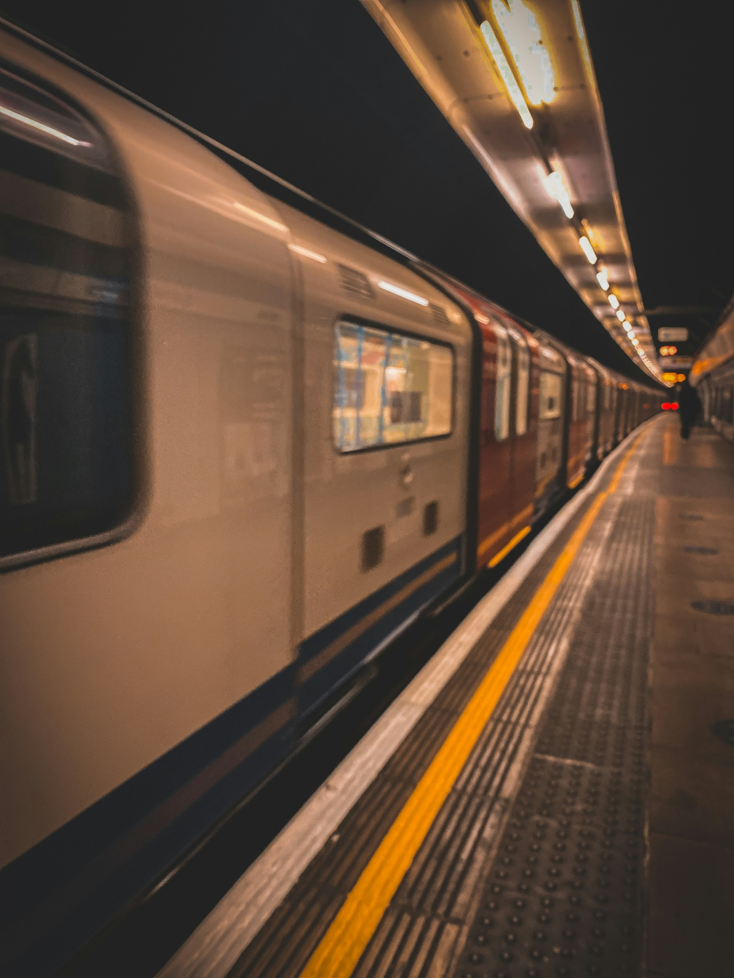
Functional Requirement (For Admin)
Enter train details ( train number, source, destination, …)
Calculate the total duration
Enter station master information ( name, phone ,Email, ...)
See and update train details
Search for the train by train number
Update train details after delay

Slide 7
Functional Requirement (For User)
See train timing
Search for the train by train number
See train departure details
See train arrival details
Reserve Ticket
Cancel Ticket
Track train location

Slide 8
Functional Requirement (For Station Master)
Capture Pictures of the railway
Find whether the railway is defective or not

Slide 9
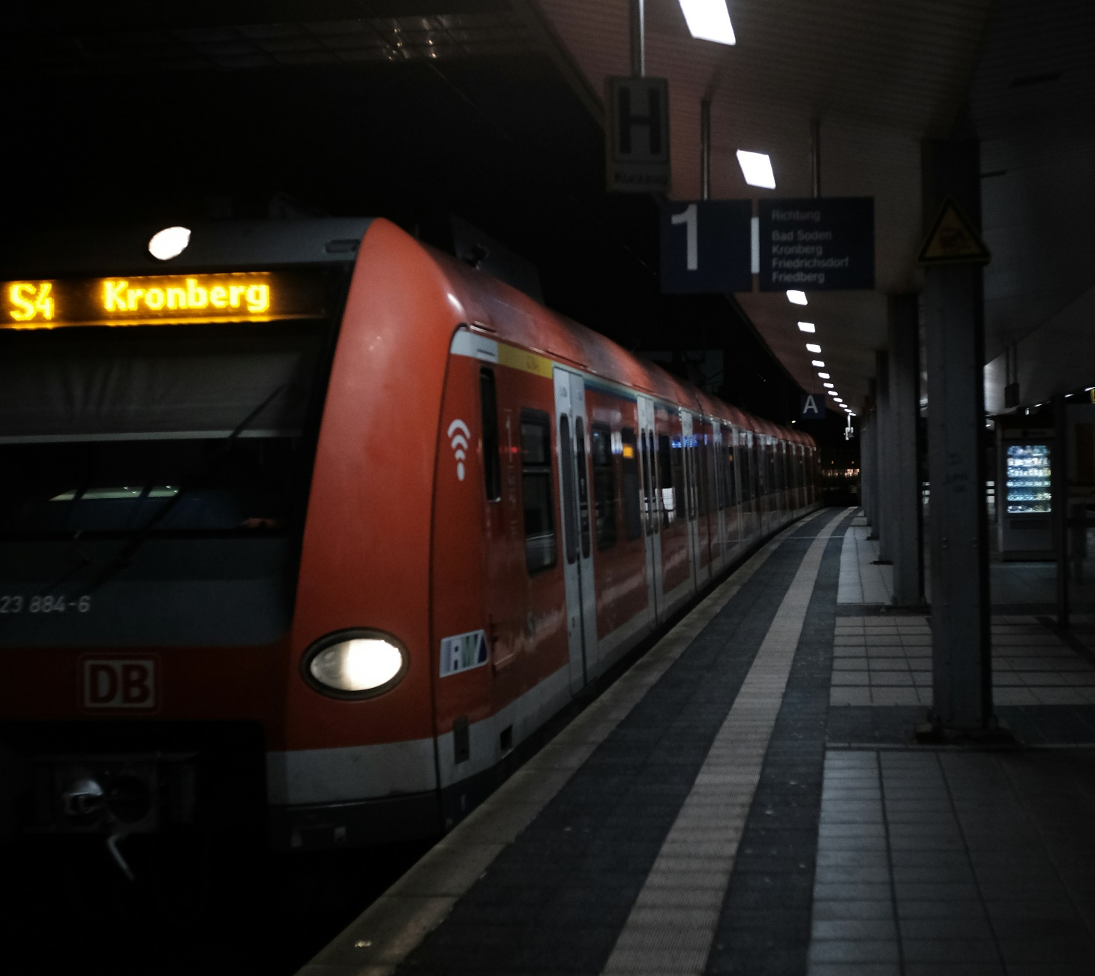
Non-Functional Requirement
(1) Security :-
Data Encryption : Ensure all data in transit and at rest
is encrypted using industry-standard encryption
protocols.
(2) Usability :-
User Interface : The user interface must be intuitive,
user-friendly, and accessible, meeting WCAG 2.1
Level

Slide 10
Non-Functional Requirement
(3) Maintainability :-
Modular Design : The system should be designed
with modularity to facilitate easy maintenance and
updates.
Documentation : Comprehensive documentation for
system architecture, APIs, and user guides must be
maintained.
it trails for all critical system actions and changes to
support compliance and forensic investigations.

Slide 11
Non-Functional Requirement
(4) Efficiency :-
Resource Utilization : Optimize system resource
utilization to minimize operational costs without
compromising performance.

Slide 12
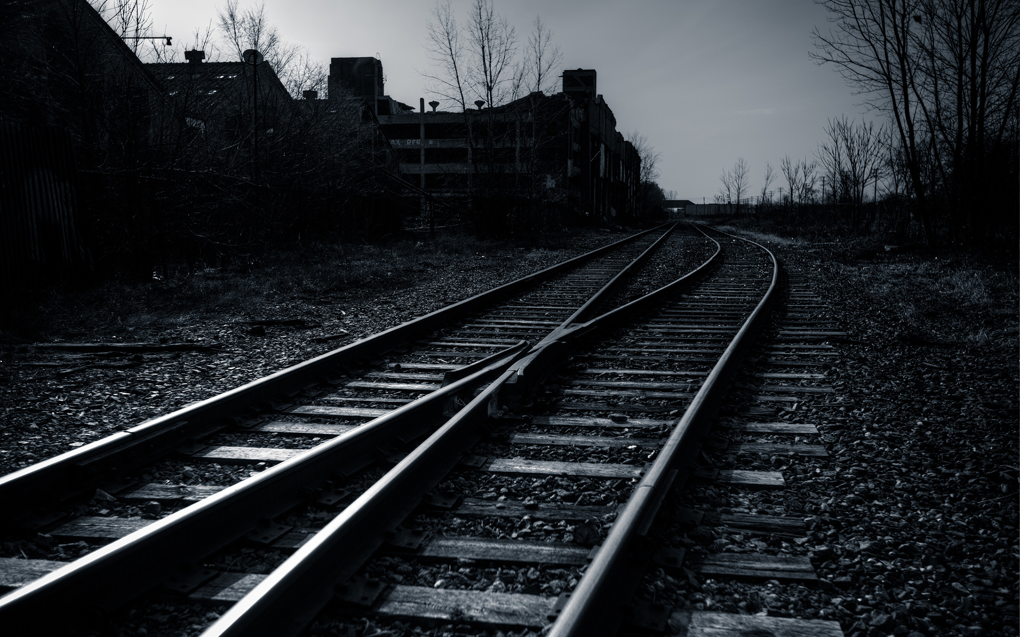
Machine Learning Model
Our machine learning model analyzes images of railway tracks taken from the
Train-master to detect defects. By leveraging advanced computer vision techniques, the model accurately classifies the tracks as defective or non-defective, enhancing maintenance efficiency and safety. This automated solution reduces inspection time and ensures early detection of potential issues, contributing to more reliable railway operations.

Slide 13






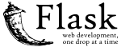
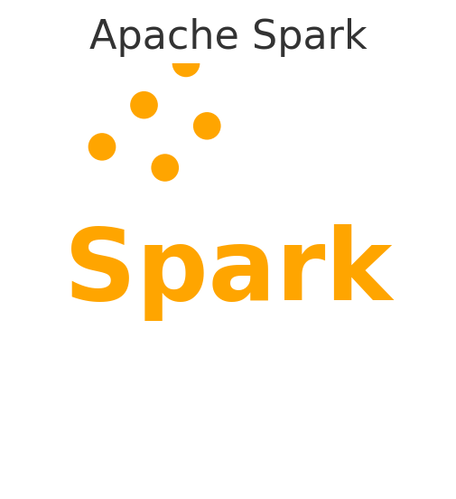
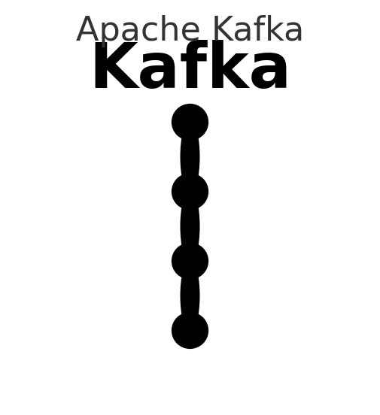
_{Front End}
_{Backend}
Technologies Used In Implementation
_{ML}
_{Big Data}

Slide 14


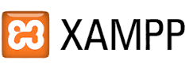
Tools Used In Our Project

Slide 15
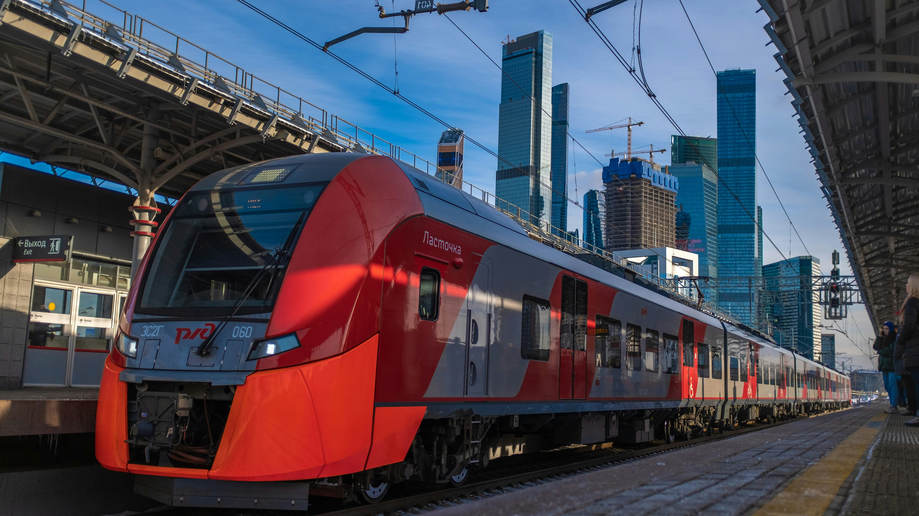
Future Work
We are going to add more and more features to our web application such as :
we will make mobile app and might involve enhancing the accuracy and efficiency of the existing systems. This could include implementing advanced machine learning algorithms to analyze historical data, integrating real-time data feeds for up-to-date information, optimizing algorithms for faster processing, and developing user-friendly interfaces for both operators and passengers. Additionally, you might explore incorporating IoT devices for better tracking and predictive analytics, as well as ensuring the system's scalability and reliability to handle increasing data volumes and user demands.

Slide 16
